Slide 1

Integration of I4.0 standards
Alina Arunova, Maxim Maltsev, Philipp Matyash, Sattar Rahimbeyli
Mentor: Irlán Grangel

Slide 2

Integration of I4.0 standards
Our web application for the integrating of I4.0 standards will use an innovative and universal approach by applying such Linked Data technologies as RDF. Its main functionalities will include:
Integrating of any kind of data from different companies, branches or departments of organizations;
Intuitive visualization of the input files and newly produced ones;
Advanced data analysis and error checking in order to produce a qualitative result after the processing.
2

Slide 3
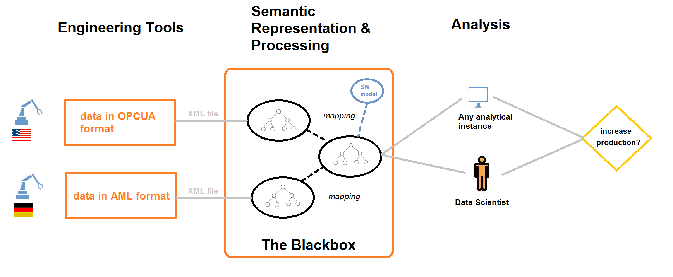
Integration of I4.0 standards
3

Slide 4
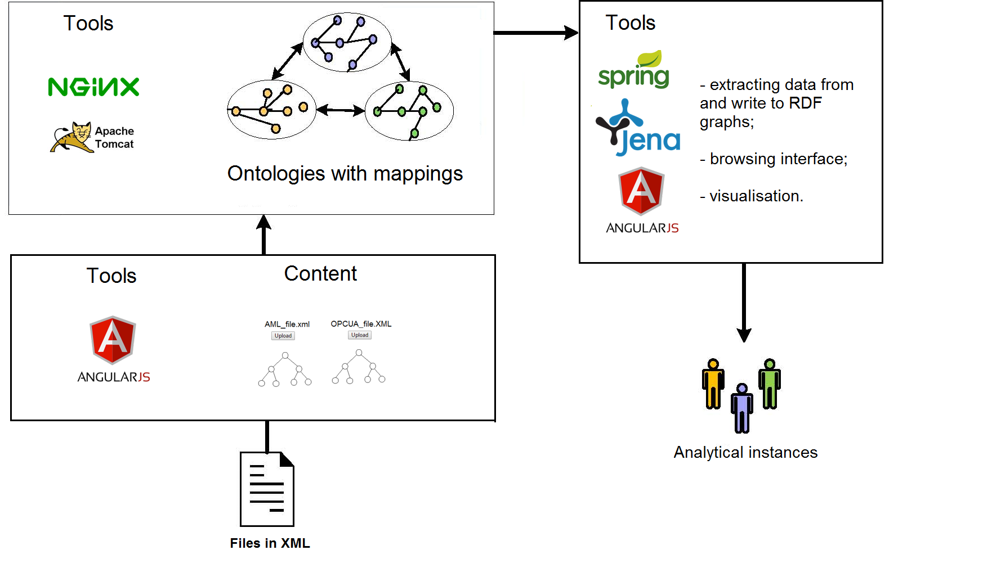
Integration of I4.0 standards
4

Slide 5
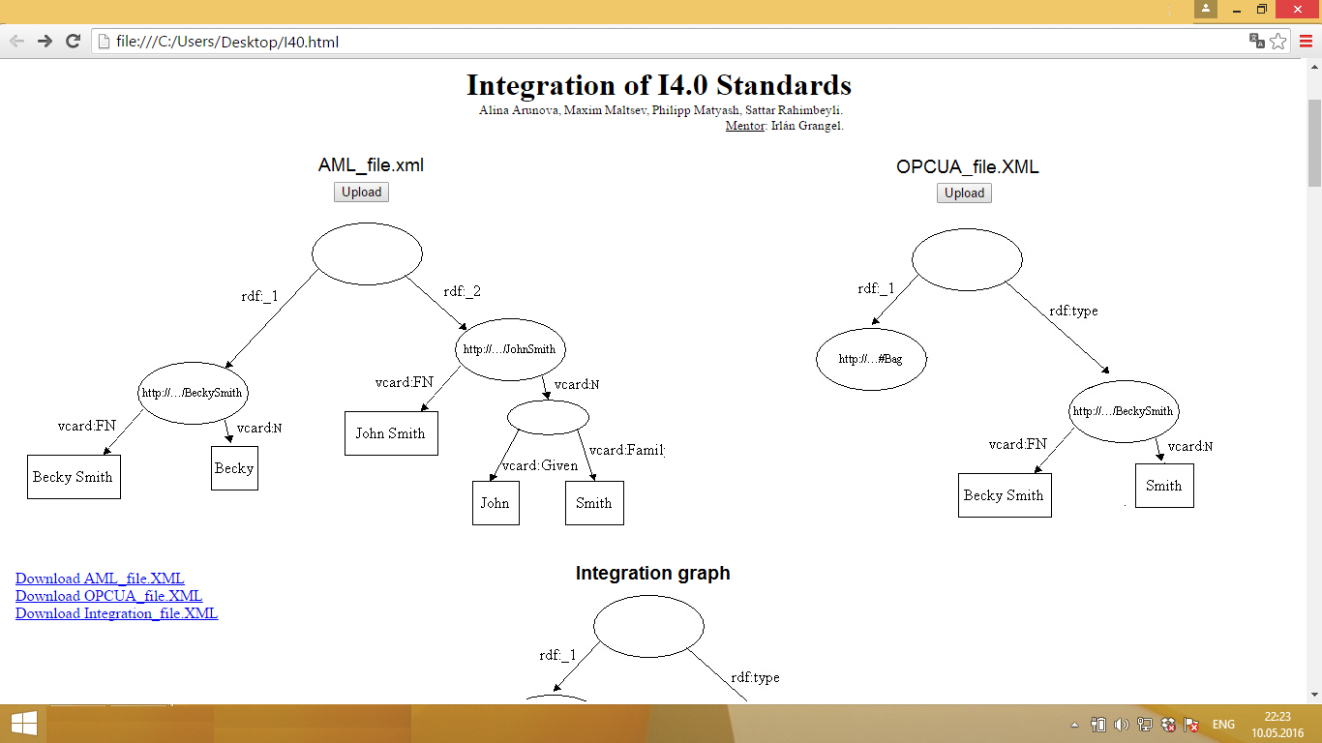
Integration of I4.0 standards
5

Slide 6
Integration of I 4.0 standards
Q&A?
6

